Slide 1

RISK AND RESILIENCE BOOTCAMP
3

Slide 2


Slide 3
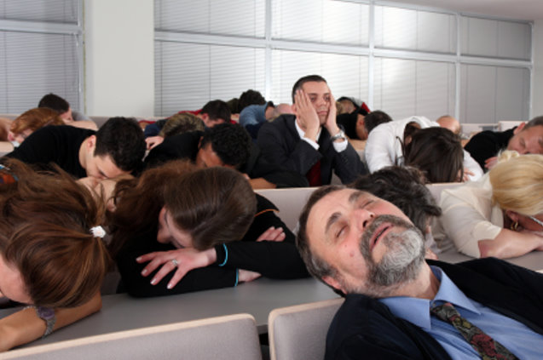
Communication skills
This module introduces and explores dimensions of communications skills

Slide 4
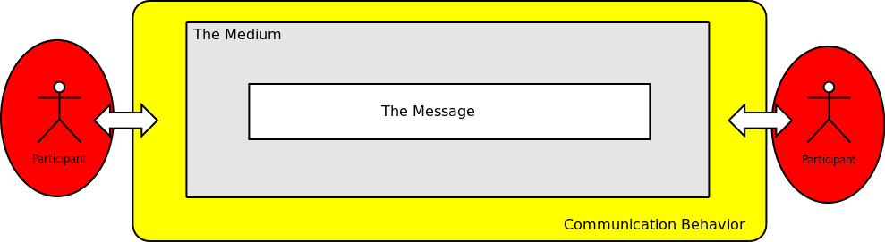
The model

Slide 5
The model
In this first section, we are going to focus on the roles of the participants in communication
The fundamental theme of this section is that different kinds of people tend to communicate differently
The first step to being an effective communicator is to be able to understand the differences in peoples' communications styles and how to adapt your communication strategies to be effective with different styles

Slide 6
People Literacy
People literacy is the ability to adopt another person's point of view and understand their style of acting, thinking and feeling in a given environment.
This is not empathy – we do not have to feel what the other person is feeling to understand what they are feeling in a particular context
People literacy, for this course, is defined as being able to:
Identify another's behavioral style.
Identify their motivations within a specific environment.
Understand their perceptions of that environment.
Identify the underlying content and issues of their communications with us and others.
Conduct a communication with them that "speaks their language" and that they are open to receiving.
Deliver and get our messages across to them in a way that produces results.

Slide 7
People Literacy
Some fundamental axioms:
All actions are self-motivated – even the choice to take no action
We cannot motivate others, but we can create an environment that will motivate people to a particular action.
People do things for their reasons, not our reasons.
If you understand what motivates me better than I understand what motivates you, then you control the communications between us
If you understand what motivates me better then I do, then you can control me
A fundamental point:
My environment is what I perceive it to be, not necessarily what is objectively there

Slide 8
The Marston Model
This is the model that was discussed earlier in the course
Dr. William Moulton Marston (1893 – 1947) developed the theoretical basis for this model in his 1928 book The Emotions of Normal People
Of course, Marston was not the first to develop a 4-style system.
The classical Greeks established four basic personality types:
Choleric
Melancholic
Phlegmatic
Sanguine

Slide 9
Behavioral Style
A behavioral style (or pattern) is cluster of preferred behaviors used to respond to stimuli in a specific situation
People often display different styles in different environments
As we mature, we learn to use various styles to adapt and respond to different or novel situations
While we can display different styles, there is usually one style in each environment which is our preferred or natural style
Our natural style in an environment is one that:
Takes the least amount of energy for us to manifest, and can actually energize us as we manifest it
We tend to manifest when we are tired or under stress
Tends to be consistent with our own personal beliefs and opinions
Is the one we tend to display when we are "being ourselves"
As we mature, we may find our preferred styles changing as a result of our life experiences

Slide 10
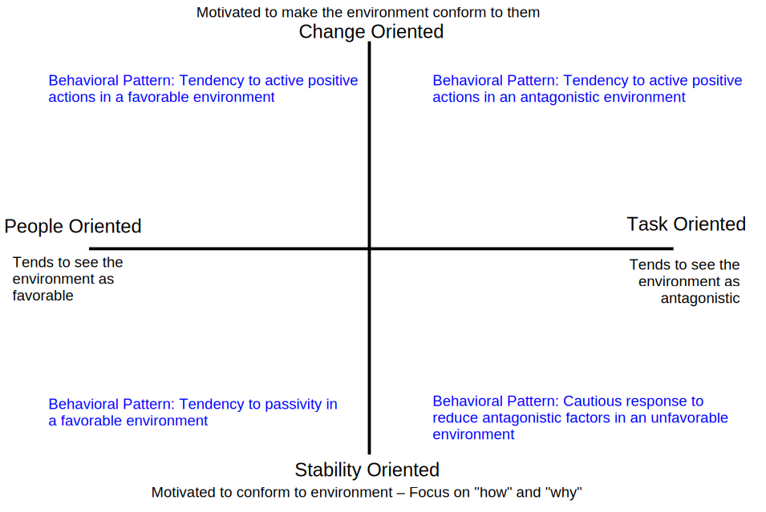
The Two Drivers

Slide 11
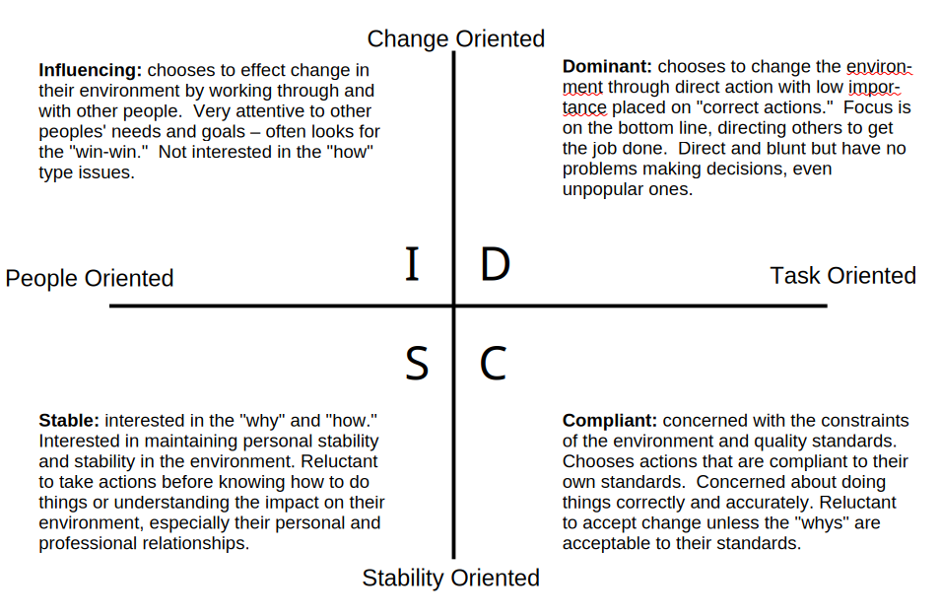
The Prototypical Styles

Slide 12
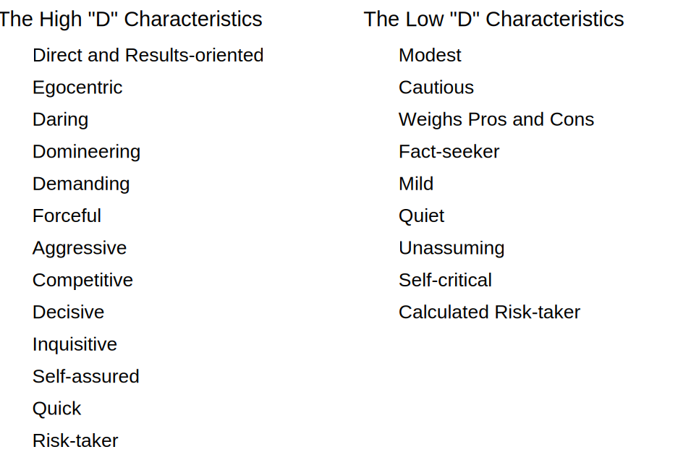
The Dominant Style

Slide 13
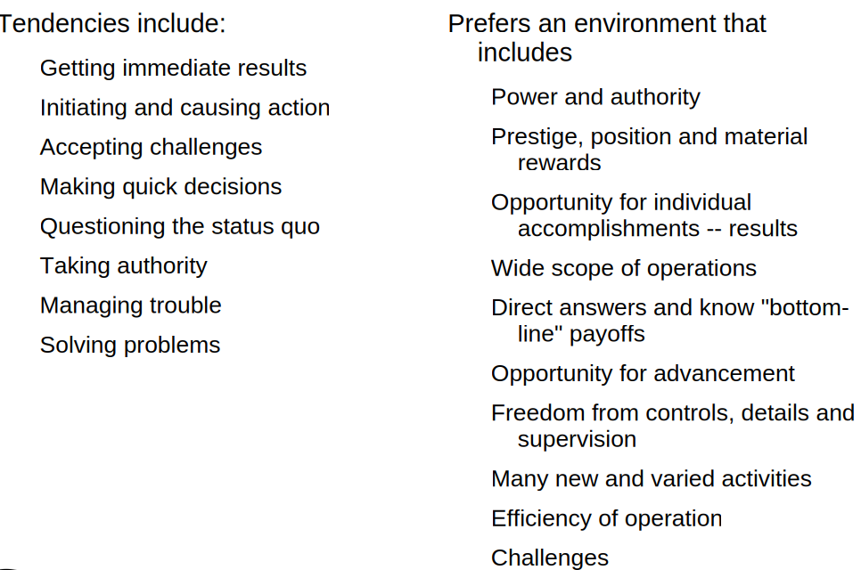
The Dominant Style

Slide 14
D Communication Strategies
Be clear, specific, brief and to the point – use communication time efficiently
Stick to business; come prepared with all requirements, objectives and support material in a well-organized package
Present the facts logically and plan your presentation efficiently and concisely
Stick to factual and "what" questions

Slide 15
D Communication Strategies
Provide key alternatives and present the choices they can decide among
Provide facts and figures about the probability of success and effectiveness of the options
If you disagree, take issue with the facts, not the person
Motivate and persuade by referring to objectives and results
Support, maintain and use discretion
Always end the communication graciously

Slide 16
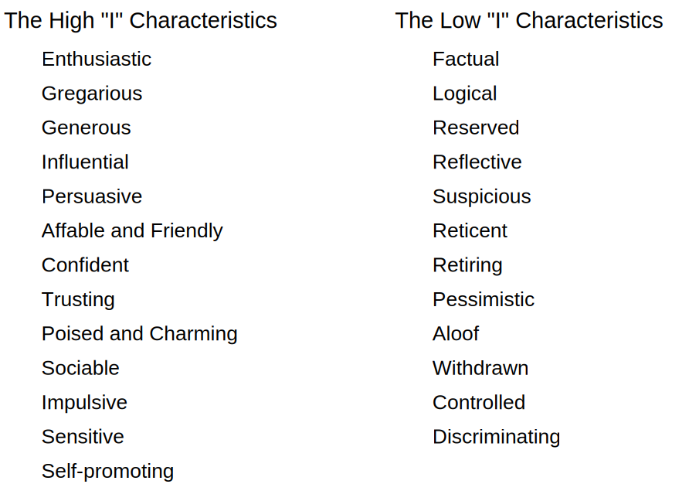
The Influencing Style

Slide 17
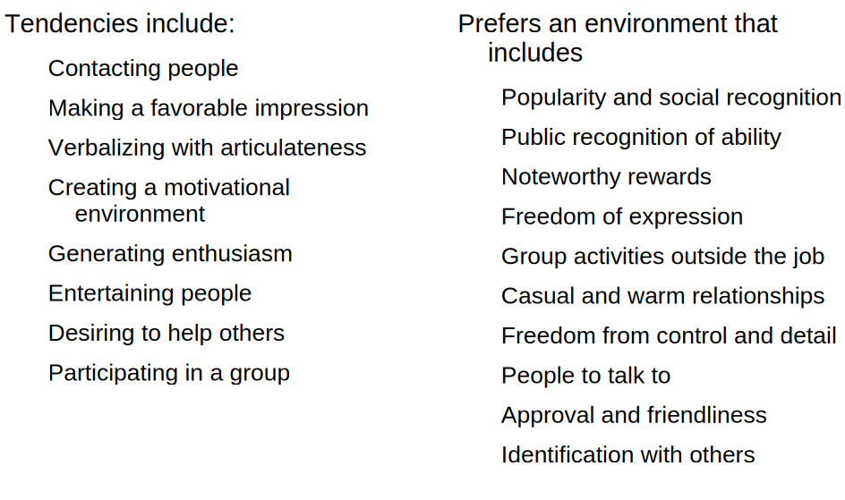
The Influencing Style

Slide 18
I Communication Strategies
Plan an interaction that supports their dreams, feelings and intuitions; use time to be stimulating with enough time to be sociable yet fast-moving
Allow time for relating and socializing
Talk about people and their goals; opinions they find stimulating
Don't deal with extensive details; put them in writing; pin them down to modes of action

Slide 19
I Communication Strategies
Ask for their opinions and ideas regarding people
Provide ideas and suggestions for implementing action
Provide evidence for your statements in the form of testimonials from people they see as important or prominent
Offer special, immediate and extra incentives for their willingness to take risks
Continue supporting the relationship in a casual and informal way

Slide 20
The Stable Style

Slide 21
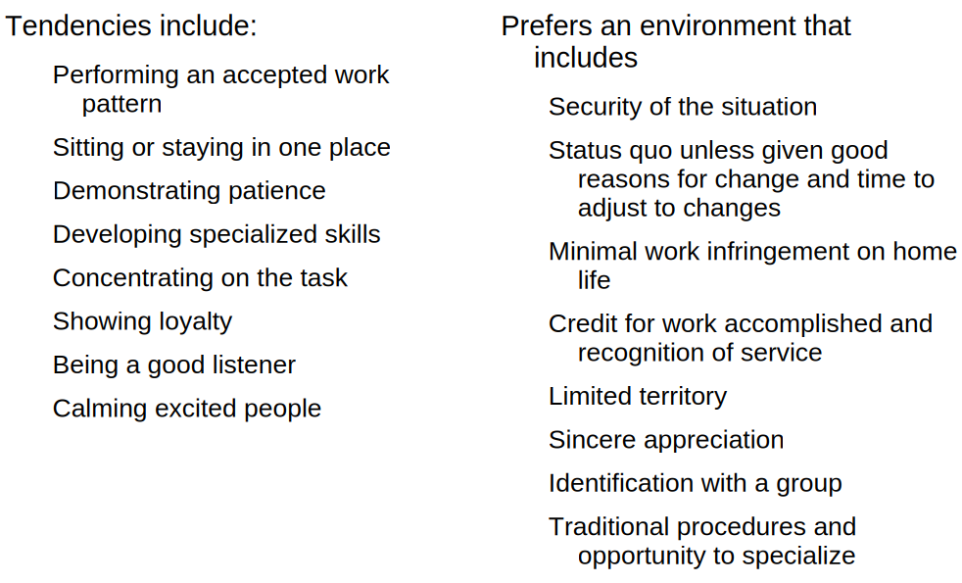
The Stable Style

Slide 22
S Communication Strategies
Always break the ice and spend time being agreeable and to reaffirm a personal commitment
Show sincere interest in them as people; find areas of common involvement and be candid and open
Patiently draw out personal goals and work with them to help them achieve these goals; listen and be responsive
Present your case softly and in a non-threatening manner, use lots of "how" questions to draw out their opinions

Slide 23
S Communication Strategies
If you agree too easily, probe for areas of disagreement; if you disagree look at personal reasons or hurt feelings as a possible cause
Keep things informal but organized
Identify ways to minimize risk if they are balking at change and provide assurances that the results of change will be positive
Backup personal assurances with concrete guarantees, with individual contributions in writing

Slide 24
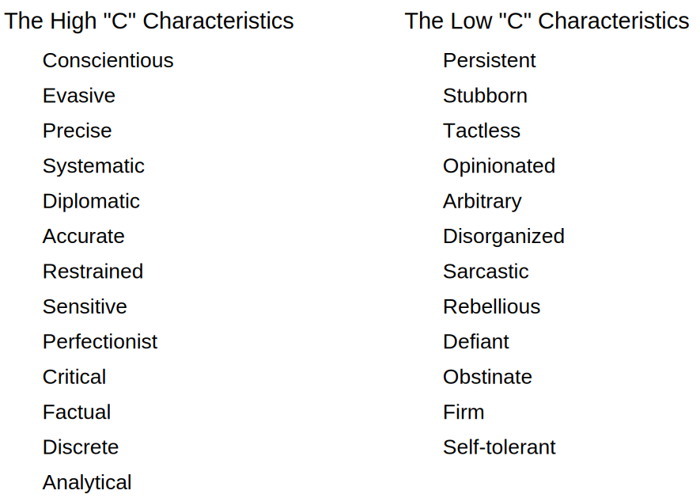
The Compliant Style

Slide 25
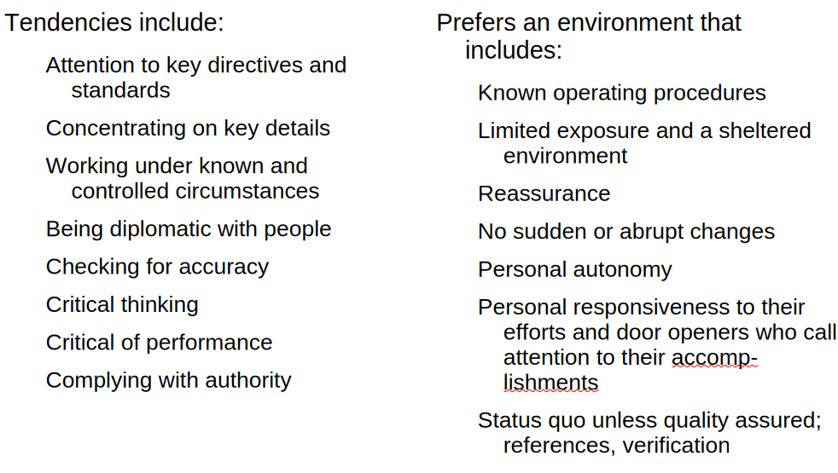
The Compliant Style

Slide 26
C Communication Strategies
Know your case in advance and be accurate. Never try to con a C
Approach then in a direct but laid-back manner and stick to business
Use a methodical approach with a fair evaluation of the pros and cons of your positions
Present specifics and be sure you deliver on what you say you will
Draw up step by step timelines for implementing action with them and assure them that there won't be any surprises

Slide 27
C Communication Strategies
If you agree, follow through and if you disagree, make an organized presentation of your position and ask them for input
Be prepared to verify your statements and to give the time to verify your facts. That means be accurate and realistic in your statements
Back up your claims with solid, tangible and practical evidence
Don't make guarantees over the long term without providing "what if" options

Slide 28
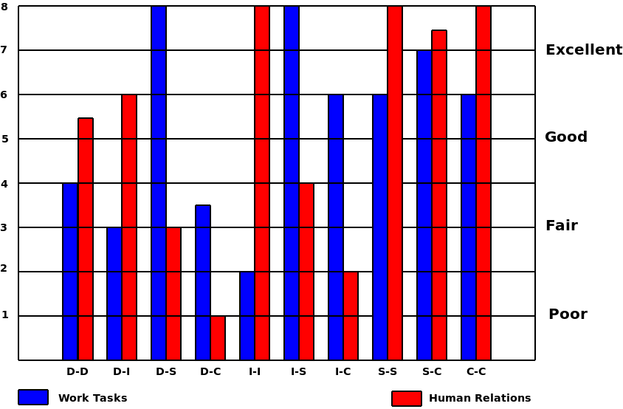
Styles Compatibility

Slide 29
Handling an Angry Person
Whenever we deal with an angry person, whether it is a customer, employee or personal relationship, we are dealing with a communication situation
In most cases, bringing and angry confrontation to a successful resolution is the result of one party the other that can
Read between the lines of the verbal fusillade to see what the real issues are from the other person's perspective
To respond with a message that is appropriate to the style the other person

Slide 30
Handling an Angry Person
A variant of this process is taught as the EASE method of handling angry customers
Empathize: Understand that the other person's anger is justified from their perspective. Tell them that you would feel the same way too if you were in their situation
Ask: Get the other person to provide the facts of the situation
Suggest: Get the complaining person to suggest a solution
Enable (or enact): Resolve the situation by applying the agreed upon remedy

Slide 31
The Platinum Rule
The Silver Rule
Don't do unto others what you wouldn't want them to do unto you
The Golden Rule
Do unto others as you want them to do unto you
The Platinum Rule
Do unto others what they would want you to do unto them
The golden rule is deficient since it implies
If I am D, I would treat every one else as a D, and other styles, like a S, do not want to be treated as if they are D's
We make EASE better by
Understanding the things that provoke anger for the other person's style
What the objective of displaying anger is for the other person's style
What resolution would be appropriate for the other person's style

Slide 32
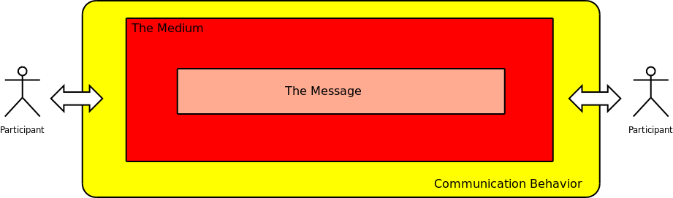
The message
In this section, we are going to focus on the message/medium aspect of the communication
The fundamental theme is that message is made up of a number of dimensions that skilled communicators can manipulate effectively
And that the medium that the message is sent over can also be manipulated by skilled communicators to change the message they are sending

Slide 33
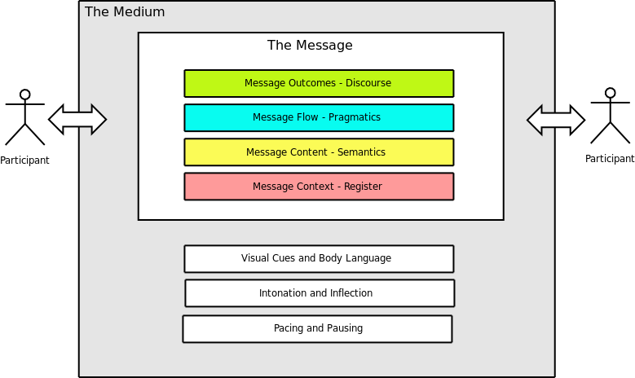
The Structure of a Communication

Slide 34
Discourse Modes
People use messages to accomplish specific outcomes
A discourse mode can be thought of as a way of structuring and presenting a message to get a certain outcome
Discourse modes, based on cross linguistic studies, seem to be universal
The main discourse modes are
Narrative: About specific people, events and things. The flow of the narrative is tied to the progression of the story
Description: About events and things. The flow of the discourse moves spatially through the scene being described

Slide 35
Discourse Modes
The main discourse modes are (cont)
Report: About specific events and things and their relationships. The flow of the discourse follows logical sequences described from "speech time"
Information: General descriptions of relationships. Flow of the discourse is through a series of topics and is atemporal
Argument: Presentation of general facts, propositions and relationships to convince or persuade. The flow of the discourse is through the logical steps of the arguments

Slide 36
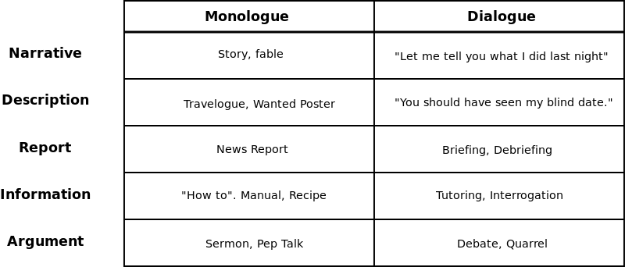
Dialogues and Monologues

Slide 37
Discourse Objectives
Narrative
To tell a story, usually following a specific person on event in temporal flow and point of view
Description
To create a depiction of a person place or thing at a moment in time
Report
To present events and individuals from the speakers point of view in current time.
Information
To present a sequence of facts or steps that focuses on the logical flow of information
Argument
To convince or persuade

Slide 38
Communications Skill
We intuitively can recognize and use these modes without being aware of them
Effective communication means being able to
Identify the discourse modes you encounter in a communication
Ensure the discourse mode of a communication is appropriate for your objectives, i.e. what you want the communication to accomplish
Be able to change the discourse mode if it is not appropriate for your objectives

Slide 39
Communications Skill
We also encounter speakers who do not use an appropriate discourse mode for what they want to accomplish with the communication
As effective listeners, we can look past the mode to the actual content
For example, children often use an argument mode when they really should have been using a report mode
We can also change the impact and effect of our message by using an unexpected mode to grab the listeners' attention
For example, using a narrative mode instead of an argument mode

Slide 40
Pragmatics and Message Flow
The pragmatics of message is how the various "thoughts" or "topics" of the message are structured so that they can be understood by the receiver of the communication
Poor pragmatics in a message usually results in the listener wondering "What is that person talking about anyway?"

Slide 41
Pragmatics and Message Flow
The basic rules of pragmatics are
Talk about one topic at a time
If you switch topics, let the listener know
If you deviate from the expected flow of the discourse, let the listener know
Follow the rules of flow for the discourse mode you are using
Backtrack and try again if the listener does not understand
Rules of pragmatics are universal.
Pragmatic markers are often part of the syntax of a language

Slide 42
Pragmatics: Topic and Comment
Topic – what we are talking about
Comment – the information we are presenting about the topic
In the narrative below, we see an example of topic continuity
Each time the topic switches, the pragmatic marker is highlighted in red
When John is the topic, the text is in black, and when the other guy is the topic, the text is in green
Knowing the topic enables us to keep track of what "he" refers to
Let me tell you about John. He is a good friend of mine, but he does like to drink a little too much. One evening, he headed off the the local pub for a couple of brews. After a few, this guy walked in who John used to work with. He really hated this guy. As for the new guy, he didn't really feel any which way about John so he just got himself a table and ordered a rum an coke. John kept staring at the guy and got madder and madder until he finally got up and went over to where he was sitting. He started cussing him until the guy laughed in his face. So he hit him.

Slide 43
Why Topic Flow is Important
The person that controls the flow of topics controls the communication.
In most communications, the control over topics tends to pass back and forth between the participants, especially in informal communications
In more structured communications, the control over the topic flow is much more formally established
Eg. In a job interview, being stopped for speeding, ordering lunch.
It is possible to subvert the normal flow of control over the flow of topics
An effective communications skill is learning how to prevent someone else from hijacking a communication by being able to identify and block these subversions
The most effective way of controlling a topic flow is by asking a question
Questions are used to introduce new topics or return to old topics
As we shall see in the next module, the social context of the conversation makes questions very powerful

Slide 44
Discourse Flow
One of the fundamental rules of discourse flow is "iconicity"
The distance between two things in discourse mirrors the actual distance between them
Distance is measured in terms of logical connectedness, or their separation in time or space
In the second sentence, the implication is that John and Mary went to the movies together, while the first does not make that implication
John when to the movies and Mary went to the movies
John and Mary went to the movies
In the second sentence, the implication is that the eating immediately followed the cooking, while the first does not have that implication
I cooked a steak. I ate it.
I cooked and ate a steak
In the second sentence, the implication is that the horse and wagon are physically in the same location
I saw a horse today and I saw a wagon
I saw a horse and wagon today

Slide 45
Discourse Flow
Another form of iconicity has to do with sequencing
The order of event in the discourse generally mirrors their causal or temporal ordering.
Consider the following sentences
Paul was shot three times by a mugger. He died last night.
I got up this morning, had a shower and got dressed.
I got up this morning, got dressed and had a shower.
I got up this morning, got dressed and then had a shower.
The first sentence shows an example of logical sequencing, the implication is that Paul died as a result of being shot
The second sentence implies that I got dressed after I had a shower
Interestingly enough, in experiments when subjects listened to the third sentence and asked to repeat it, most responded with the second sentence
In the fourth sentence, we see an explicit marker that overrides the implied time sequence of events

Slide 46
Why Iconicity is Important
How a discourse is structured adds meaning to the semantics of the words and sentences
Many people use these discourse elements to add "unstated" implications and meanings to their messages
This is a normal part of speech and usually is not a problem
However, it can be used to make "deniable assertions,
Because these deniable assertions are not associated with a specific sentence or statement, it is possible to innocently state afterward "But I never said that!"
Understanding how these pragmatic mechanisms works allow you to
Identify when these are being used on you
Be able to challenge someone in order to force them to assert exactly what they imply
Help you avoid implying something you don't mean

Slide 47
The Social Content of a Communication
There are two primary dimensions of social information encoded into every conversation
The first is information about the level of formality of the conversation
We call this the the social distance between the participants
This information is always encoded into a communication
The second is information about what we call the axis of solidarity and power
This information is used to describe either a bond between the two participants, or a subservient relationship
This information is not always present, although the structure of some languages, like French, ensure it is always present even if not used
In every communication, this social information is used to enhance or modify the effectiveness of the communication

Slide 48
Linguistic Register
A register is a form of a language that is used in a specific social context
Every aspect of a language may vary within a register
Pronunciation, word choice, sentence structure, discourse forms, grammar, inflections, pitch, intonation patterns, pacing and other dimension of the communication
One of the problems we have in learning a language is not the acquisition of the language itself, but learning all the different registers and when to use them
A common register that we are generally unaware of in our normal speech is a gender register
English has a special register that only women use
Men who use female forms are identified as sounding "effeminate"
In some languages, women actually speak a distinct dialect among themselves

Slide 49
The Hymes Universal
Social distance is iconically represented in a message
The length of the message mirrors the amount of social distance
The length of the message may be represented by
The pacing and time to deliver the message
The length and complexity of the words
Isn't versus is not
Car versus automobile.
The complexity of the grammatical constructions and number of linguistic units used
John submitted the report.
The report has been submitted by John.
The report has been properly and duly submitted by an individual identified as John.
You can use the Hymes Universal to modify the social distance as well by choosing more or less formal language structures

Slide 50
Power and Solidarity
Language can be used to express power relationships and solidarity relationships between and within social groups
Power relationships are illustrated by the use of the French pronouns tu and vous
Although the usage is more fluid now, historically we used "vous" to address superiors, and "tu" to equals to express solidarity and to inferiors to express power
Solidarity is more well attested
Groups differentiate themselves from the mainstream by developing a private register, which many include a jargon
Group solidarity is shown by using the private register when talking to another group member

Slide 51
Semantics
The semantics of a communication refers to what the communication means
We have seen that what we say can mean something other than what is stated and can imply things without saying them
We normally think of semantics a dealing with the meanings of words
This is a very large subject so we will only touch on three points or observations about semantics that are relevant for this course
Observation 1
Meanings of words interact with pragmatics to create different kinds of messages
Consider the difference between the statements
He stood up.
He stood himself up.
He stood up himself
Or
He went shopping for a car.
He went car shopping.

Slide 52
Semantics
Observation 2
There are no synonyms
We have all learned in school that synonyms are two words that mean the same
However, in reality, while some word share similar meanings, for any pair of putative synonyms, there is always at least one place where you could use one of the pair but not the other
Observation 3
Word meanings are not fixed
All of our word meanings are idiosyncratic
We have a set of more or less common meanings that we more or less agree on
But my meanings are not your meanings

Slide 53
Intonation and inflection
Intonation refers to the tonal contour of a sentence
Inflection refers to the emphasis on the individual word groups within a sentence
Inflections and intonations tend to convey speaker opinions about the message they are sending or about the receiver of the message
Best way to understand is to jump into some examples....

Slide 54
Gesture
Gestures, including facial expressions, are an alternative channel for communication within a message context
Gestures are much more efficient than speech because they pack a lot of information into a small symbolic representation
Gestures are either stylized and register specific or are idiosyncratic
Idiosyncratic gestures are those that have meaning to a small number of communicators
These gestures depend on "shared cognitive space"
"They had been married so long that they could converse all day long without saying a word, all they needed to do was look at each other in a particular way and one would know exactly what the other was thinking"

Slide 55
Body Language
There is no universal body language
Body language is cultural
Between two communication participants from the same culture, body language serves the same role as intonation and inflection
Between participants from different cultures (Vancouver and St. John's could be considered different enough to fall into this category), body language is not reliable

Slide 56
Body Language
But there is an exception
Dr. Paul Ekman has discovered that there exist a number of basic and autonomic "action units" that make up human facial expressions
These AU are universal and reveal our emotional state so unerringly that it is possible to read someone with 100% accuracy
The reason is that facial expressions are tied to emotions and originate in a specific part of the brain: and we also have a specialized part of the brain that does nothing but process visual data when we look at someone's face
However, it takes experience and practice to utilize these effectively
But we all do it
Example: “That looks like a fake smile”

Slide 57
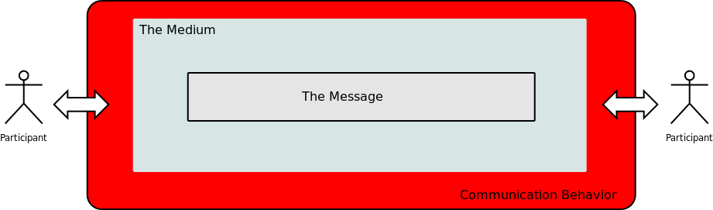
The speech contract
In this section, we are switch our focus on the process of communication and the speech contract that governs that process
Communication is a social act and is governed by the same rules as other social processes

Slide 58
The speech contract
A contract is an agreement that two parties participate in that binds them to specific actions
The philosopher H.P. Grice noted in the late 1970's that discourses were governed by a social contract of great strength
In fact, this speech contract is so powerful, that a deliberate violation of the contract by one party in a communication can cause a violent reaction from the other
“Our talk exchanges do not normally consist of a succession of disconnected remarks, and would not be rational if they did. They are characteristically, to some degree at least, cooperative efforts; and each participant recognizes in them, to some extent, a common purpose or set of purposes, or at least a mutually accepted direction.
This purpose or direction may be fixed from the start (e.g., by an initial proposal of a question for discussion), or it may evolve during the exchange; it may be fairly definite, or it may be so indefinite as to leave very considerable latitude to the participants (as in a casual conversation).
But at each stage, SOME possible conversational moves would be excluded as conversationally unsuitable. We might then formulate a rough general principle which participants will be expected to observe, namely: Make your conversational contribution such as is required, at the stage at which it occurs, by the accepted purpose or direction of the talk exchange in which you are engaged. One might label this the COOPERATIVE PRINCIPLE.”

Slide 59
The speech contract
Maxims of the Speech Contract
QUANTITY relates to the quantity of information to be provided:
1. Make your contribution as informative as is required (for the current purposes of the exchange)
2. Do not make your contribution more informative than is required
QUALITY - ‘Try to make your contribution one that is true’
1. Do not say what you believe to be false
2. Do not say that for which you lack adequate evidence
RELATION - ‘Be relevant’
MANNER - ‘Be perspicuous’
1. Avoid obscurity of expression
2. Avoid ambiguity
3. Be brief (avoid unnecessary prolixity)
4. Be orderly
Unlike discourse forms, the speech contract governs our behavior

Slide 60
Implicature
The speech contract allows us to understand implicature or cases where what a speaker means differs from the meaning of the message used by the speaker
These are often called indirect speech acts
"I'm not going to Bob's party. I have to work."
At no point do I state that I cannot go the party because I have to work, but under the maxim of relevance, the statement I have to work must be relevant to the first statement
"Bob must be doing well at his new job. He hasn't been arrested yet."
There is no statement that Bob is doing anything dishonest, but there is an implicature that he is
Speaker A: "Bob doesn't seem to have a girlfriend these days"
Speaker B: "He does spend a lot of time in Montreal."
A powerful example of relevance is the fact that when we are asked a question we either have to answer it or explicitly state that we will not answer it – ignoring it is not an option

Slide 61
Implicature
Implicature is a mechanism that is used to make communication more efficient
Speaker A: I only have a quarter of a tank of gas.
Speaker B: There's a gas station a block from here.
This implicature makes sense if A and B are in the car; it makes less sense if the two are on a long distance call
The implicature is the whole chain of unstated assertions that are assumed by two participants
Deliberately ignoring the speech contract is also a form of implicature
John asks Tom if he did some thing wrong
Tom continues to stare at the TV screen in silence.
Mary asks her manager Sue if she thinks Mary got her promotion.
Sue immediately asks Mary if the quarterly reports are ready.

Slide 62
Implicature
Implicature is a normal part of the speech process
However it is also used to change the meanings of communications through implication and the creation of deniable assertions
The ability to identify implicature, especially when they are being used to manipulate a communication is a vital part of communication competence
Point for discussion:
What is the relevance of what we have been discussing to the old adage Always answer a question with a question?

Slide 63
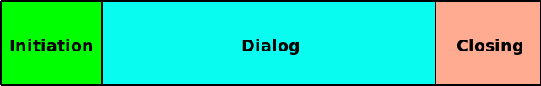
The Communication Process
Consider at the sequence of event that make up a communication
Every communication has three phases
Initiation: The terms of the speech contract are brought into play and the nature of the communication (discourse mode for example) is established.
Dialog: The actual communication.
Closing: The ending of the dialog and the completion of any loose ends that need to be tied up to fulfill the speech contract.

Slide 64
The Initiation
The initiation is an exchange of information that starts the dialog
During the initiation, either party may reject the dialog (in most cases) which ends the communication
Basic speech contract and social contract ground rules are established
What language we will use
Physical parameters: location, time allocated
Type of dialog or discourse
The social distance between the participants and the establishment of any power or solidarity relationships
One of the other functions of the initiation is to establish rapport
One dimension of rapport is the degree of trust that is established between the parties
Another dimension of rapport is the degree of intimacy that is allowed between the parties (in terms of how revealing the dialog should be)
Another dimension of rapport where either one or both participants adjust their behavioral styles to accommodate the other

Slide 65
The Dialog
There are two many dialog types to list here, so we will do that as a class discussion
However, we can identify three main types of dialogs
Formal: These have a structure that is followed by both parties
Examples: Giving testimony, serving a customer in a restaurant, a wedding, a meeting
The structure may be embodied in rules of procedure
Ritual: These have a structure that is informally known and, while there is no requirement to follow the structure, people tend to anyway
Examples: Going on a date, asking for directions, asking your boss for something
Informal: These have no structure and are characterized by a free give and take – the structure evolves with the dialog

Slide 66
The Closing
All dialogs must have a closing
Just stop talking and walk away when talking to someone to see what happens if you skip the closing
A closing can be initiated by either party in most dialogs, but in some formal and ritual dialogs may be the prerogative of only the one who controls the dialog
Closings allow for a finalization of any social requirements
Thanking the other person for their time
Making arrangements for the next encounter
Closings may be the result of a formal dialog coming to an end
In this case a closing formally frees the participant from their obligations
"The witness is excused."
"Am I free to go now officer?"
"I have no further questions. We'll be in touch if you make the short list."

Slide 67
The interview process
In this section, we are going to walk through an interview process as an example of communication
We will use this to tie together many of the aspects of what we have talked about so far
Discourse modes, speech contract, rapport and listening skills for example
The interview scenario will defined for you by the instructor
There will be four interviews held
Each interviewee will be one of the styles we looked at in a previous section
You will be expected to be in control of the interview using the techniques that we have been looking at in class
However, unlike real life your can call a time-out at any point
You can also re-wind the interview and redo any part of it that didn't go as well as you liked

Slide 68
The interview process
There are three stages to the interview
Pre-interview planning
Conducting the interview
Analyzing the interview results.
Planning the interview.
There should be two people conducting the interview if possible
One person may miss critical points
One person can observe and record while the other interviews
There may be a better match between the interviewee and one of the interviewers
Research the person being interviewed and know why you are doing the interview -- i.e. research, research research

Slide 69
The interview process
Identify
What the ideal outcome of the interview is
What the minimal acceptable outcome is
Be prepared to end the interview if the minimal outcome cannot be achieved
Prepare
A list of questions you need the answers to
Think of this as a script for the interview
Rehearse
Practice the interview so that you know the script and can focus on the answers rather than worrying about what you are going to say next
Anticipate what can go wrong and how you will recover from it

Slide 70
Question Types
Types of Questions
Polar: Can be answered with a yes or no
Closed: Require a single factual response
Open: Require a description or narrative
Probing: Require a expression of opinion
Examples
Polar: “You are the director of operations?”
Closed: “How many people are employed in this department.”
Open: “Could you walk us through the purchasing process?”
Probing: “What do feel are some of the ways we could improve the purchasing process?”

Slide 71
Conducting the Interview
Always confirm the appointment in advance
Arrive early to accommodate unforeseen delays
At the start of the interview
Ensure that the client is ready to be interviewed and be prepared to postpone if this is “not a good time”
Confirm the amount of time available for the interview
Confirm why you are there
Do not assume any of the above
Structure the interview around the Communication Triangle
Discuss the above with reference to behavioral styles

Slide 72
Communications Triangle
Rapport
Collect
Probe
End

Slide 73
Mechanics of the Interview
In the probing stage
Feed back what you know for validation
Avoid cliches like “I hear you saying…”
Be natural
E.g. “Let me go over this process you just described to see if I have it right. First the …”
In the end stage
Use probing questions to get at possible underlying issues
E.g “Do you think are some of the possible problems we could run into on this project?”
At this point, what the client “thinks, feels or believes” may be different than what they are supposed to tell you
Be prepared to go “off the record”

Slide 74
Mechanics of the Interview
If you are talking, you are not collecting information -- the client should be talking about 80% of the time
The interviewee is always right. Don’t argue. Don’t fawn.
Keep the information flowing with prompts like
“How do you mean?”
“Can you give an example?”
“Why?”
“Is that everyone’s opinion or do other feel differently.?”
“Could you explain that in a bit more detail?”
Try to avoid probing questions early until rapport is built
Use polite silence
Avoid what annoys you when you are being interviewed
STAY IN CONTROL!!

Slide 75
Mechanics of the Interview
Always incorporate a “door-opener”
“Is there anything we have not discussed today that you think we should have?”
“Are there any issues that we have not raised that you believe are important to what we have been discussing?”
“Is there anything you feel we should have asked you but didn’t?”
Bring closure to the interview.
The best way is to discuss what should be done next -- other people to interview or a review of the interview result
Keep the door open for future contact
“If you think of anything else, please give me a call”

Slide 76
After the Interview
Immediately after the interview
Review your notes and record any additional observations
You will forget critical details quickly unless you review them right away
You may discover critical points in the review that you did not pick up on in the interview
Plan your next steps

Slide 77

Q&A and open discussion
Notes:
Now is the time to engage in an interactive Q&A session where you can ask questions, share insights, and clarify any doubts about the topics we have covered so far.
This open discussion is designed to ensure that every participant has the opportunity to voice their thoughts and learn from the collective experience of the group.
Your questions and comments are valuable as they help us identify areas that may need further explanation and enable us to tailor future sessions to your needs.
We encourage you to speak up and contribute to the dialogue, as this interaction is one of the key components of our interactive learning approach.
As the session progresses, take note of any questions or ideas that you would like to revisit, and feel free to share your perspectives with the class.

